Slide 1
Going the Distance with Oracle APEX
Paramaribo, mei 2019

Slide 2
Going the distance
Sports metaphor

Slide 3
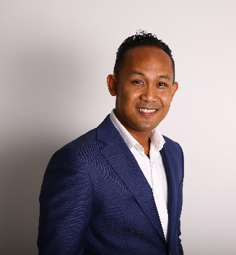
Your Coach
Sullivan Kromosoeto
Mechanical Engineer turned Database Developer/ APEX Specialist
10 years experience
Retail, Insurance, Banking
QSR to QNL
Currently Senior Apex Developer at AS Watson
Field Manager at QNL

Slide 4
Your team
QSR, Nilesh, Felicia, Shane, Michelle
Rudennis, Jane,
Combined experience min 20 years
Daily runners

Slide 5
Warming Up
Apex.oracle.com
http://bit.do/apexws0-60
Workspace
App Builder
SQL Workshop
Team Development
App Gallery
Good to know
Run time environment vs App Builder
Region
Items
Shared Components

Slide 6
Warming Up – Lets build
Import all apex apps
Instructions.txt
Drive

Slide 7
Take off!
Develop your own pages

Slide 8
Hitting your stride
Add some validations
Add some logic

Slide 9
The home stretch
Add some client side behaviour

Slide 10
Questions?

Slide 11
Thank You!

